Slide 1

Could Your Phone Radiation Hurt You
Hypo 1910273011

Slide 2
Smartphone is all around us all the time.

Slide 3

How do our smartphone work?

Slide 4
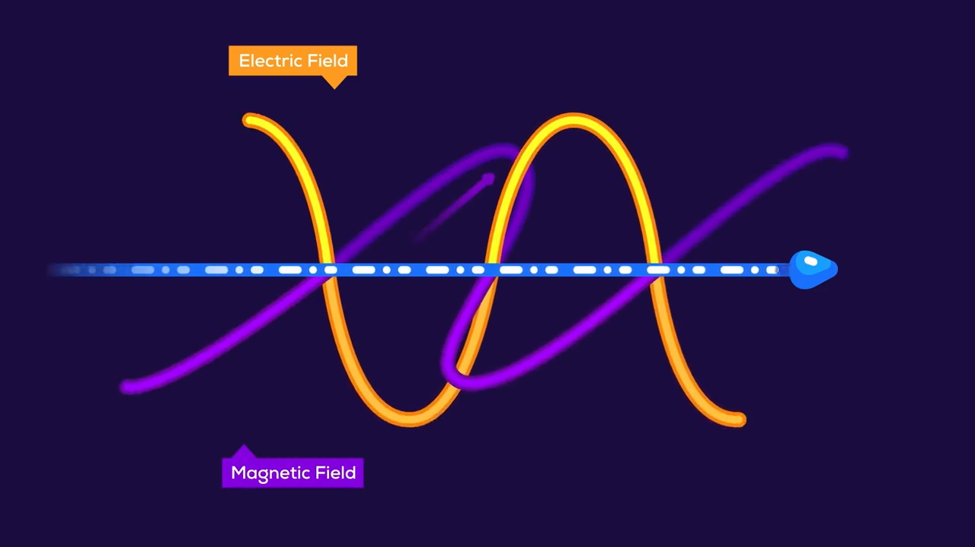
Also called Radiation
Use electromagnetic wave to transmit information

Slide 5
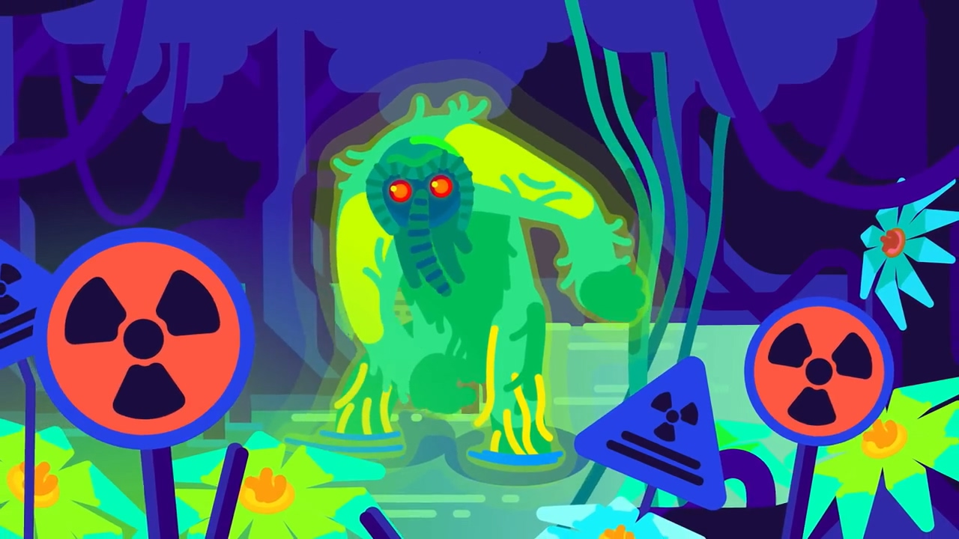
Radiation is a word that makes people very nervous.

Slide 6
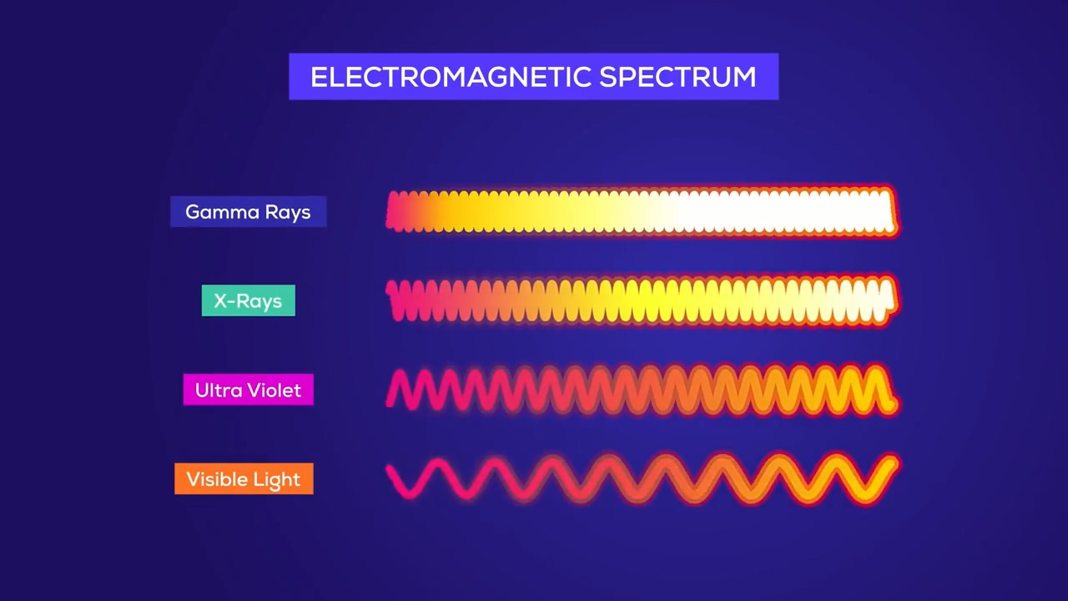
dangerous
dangerous
safe
Radiation can be divided into many types

Slide 7
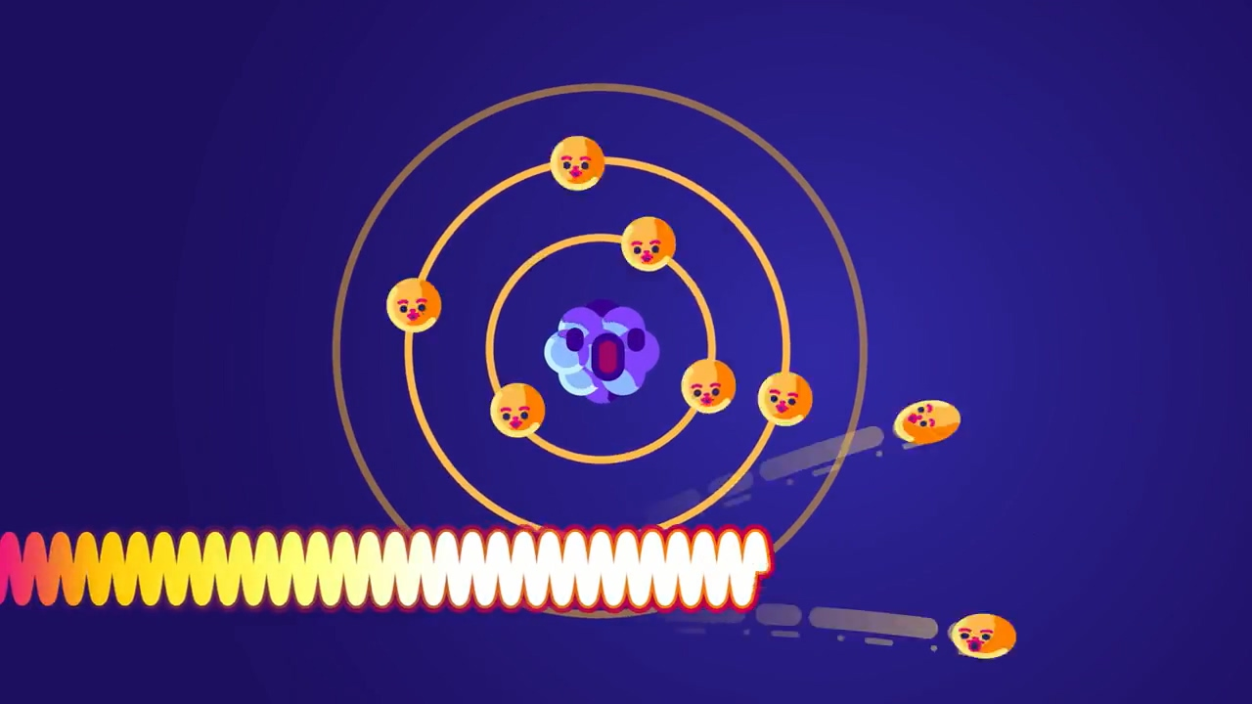
They are strong enough change atom structure

Slide 8
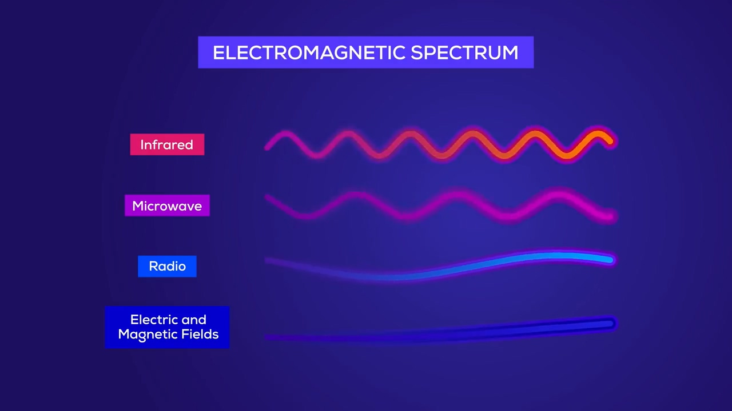
safe
safe
safe
safe
Electromagnetic is Safe

Slide 9
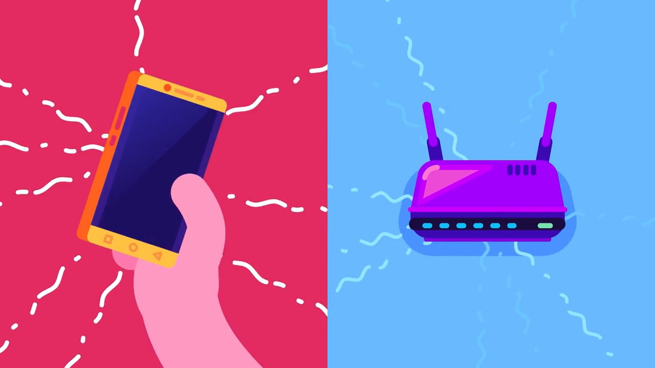
Electromagnetic is Safe

Slide 10
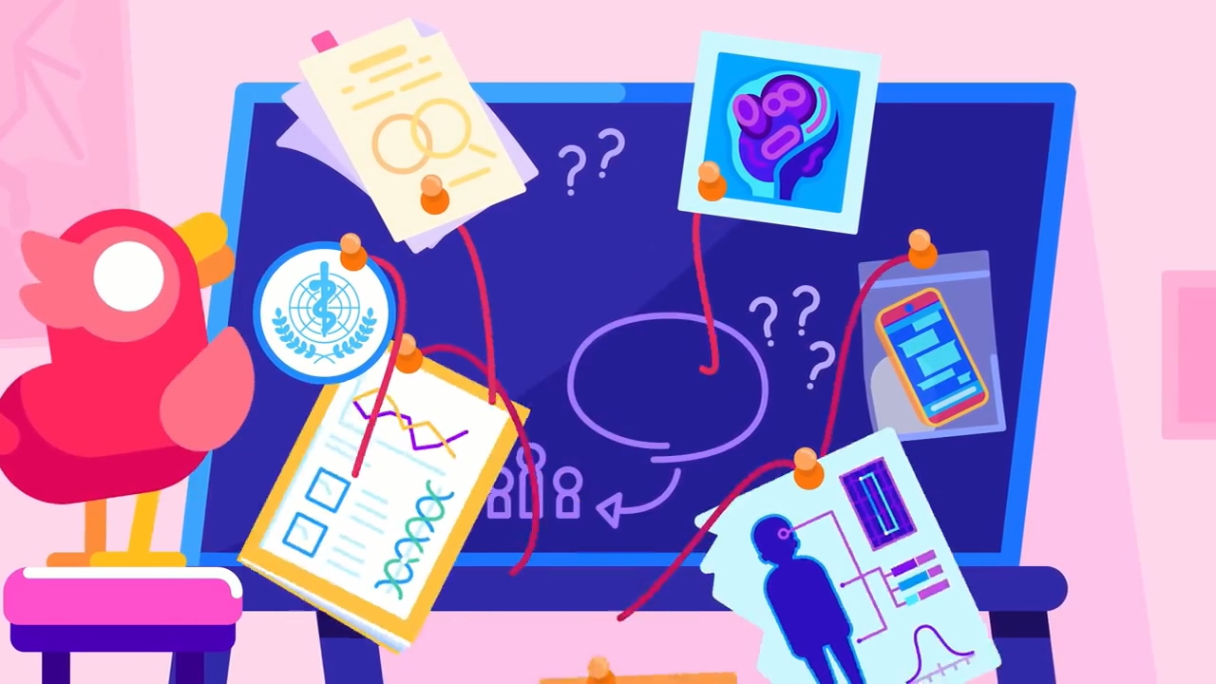
No evidence

Slide 11
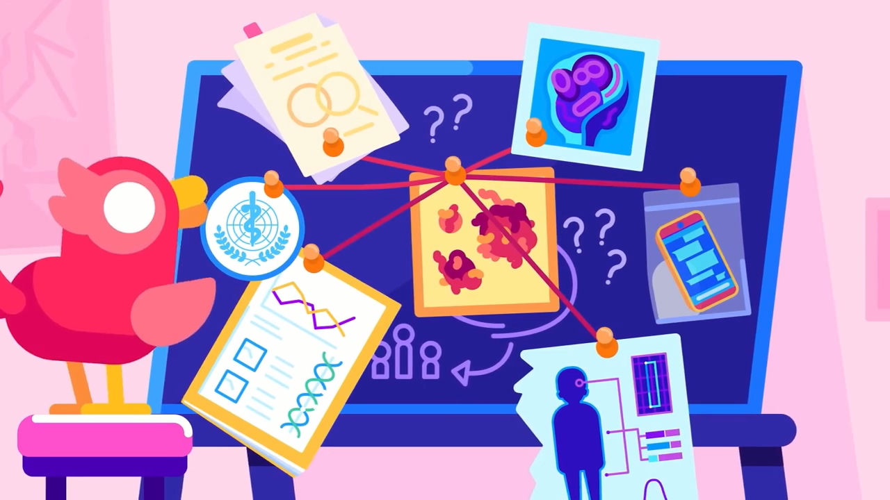
But why do Many people believed that

Slide 12
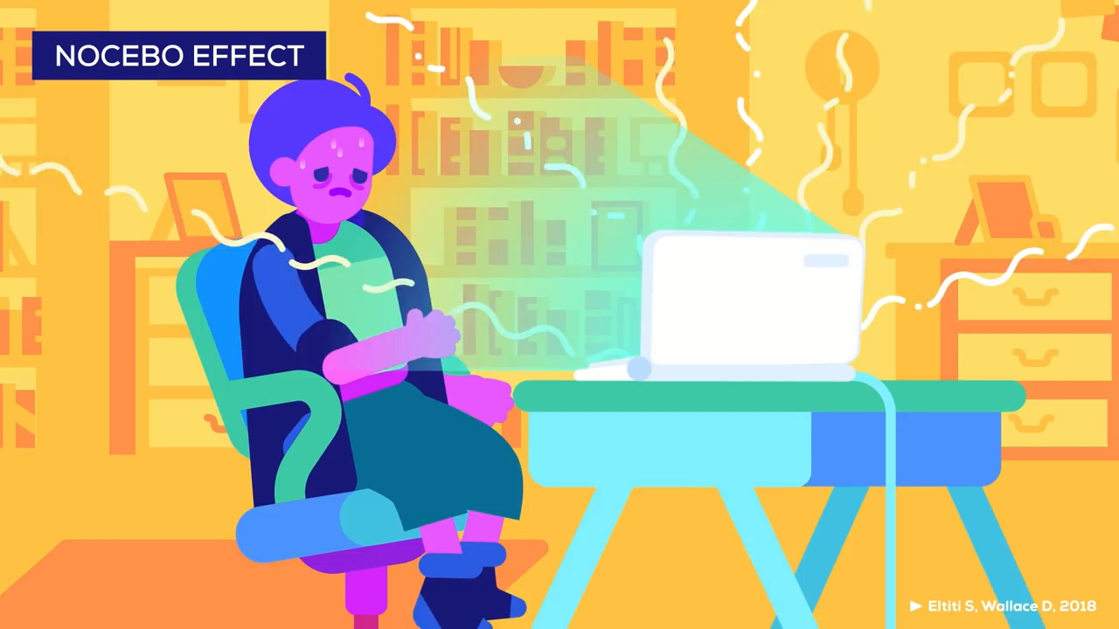
But why do Many people believed that

Slide 13
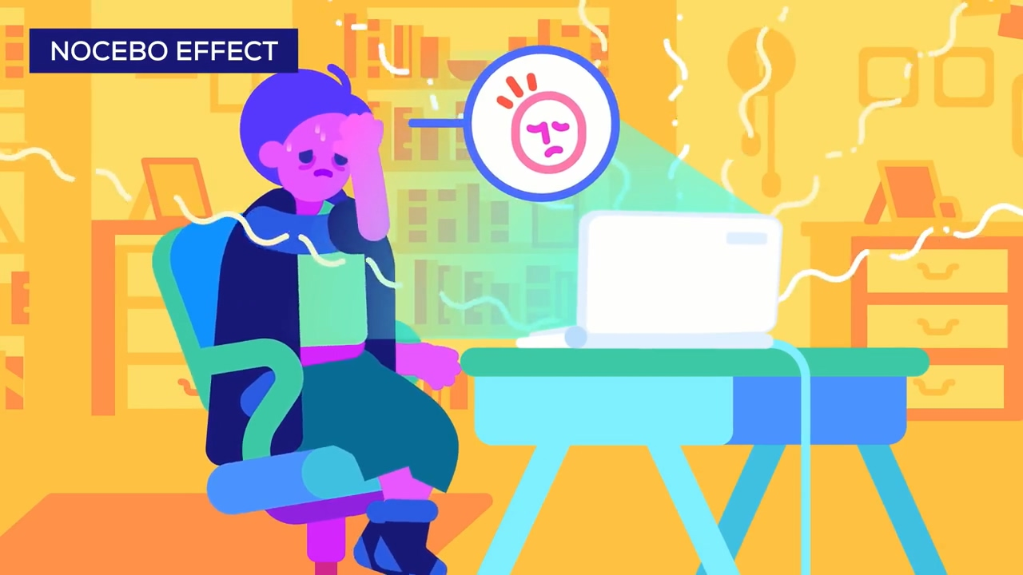
If you have a headache and are using laptop

Slide 14
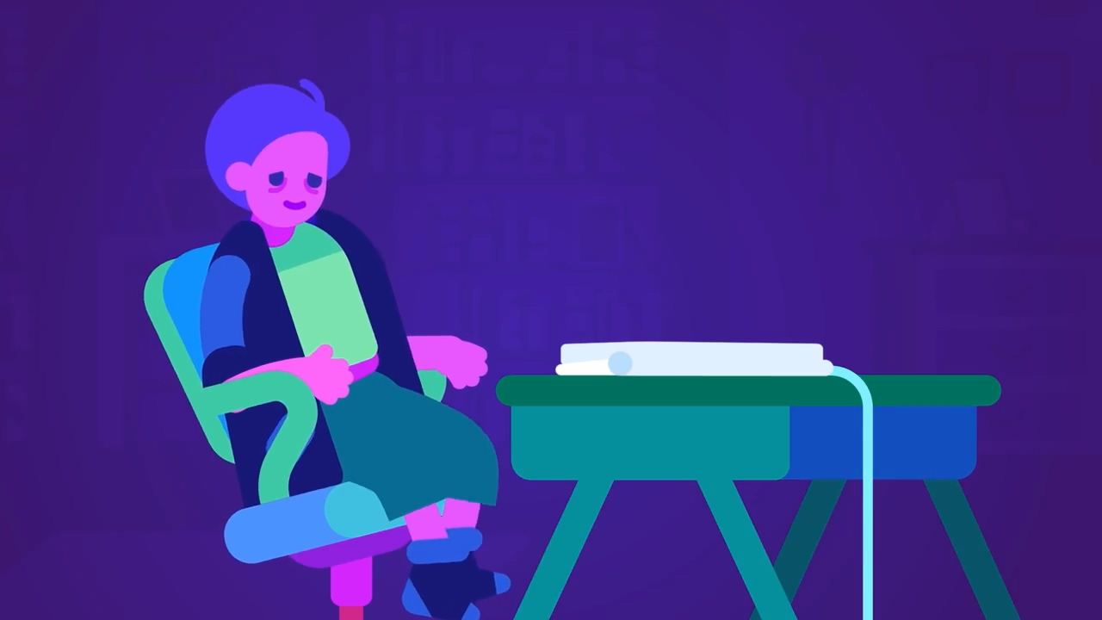
And happen to start fell better when you turn off your laptop
you might see a connection between headache and laptop

Slide 15
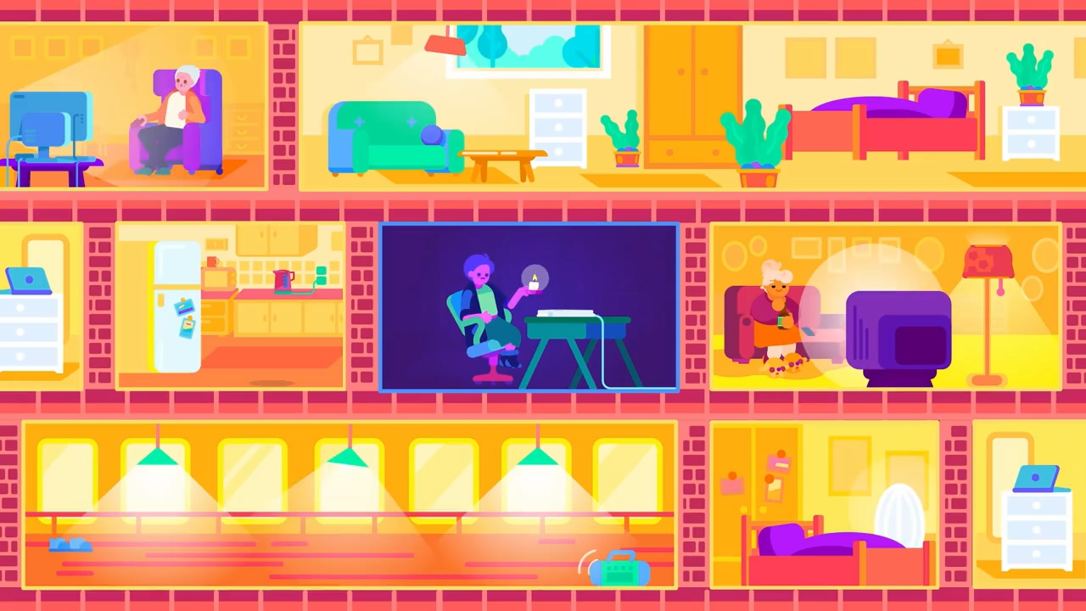
Once you get this idea, you might believe it is true

Slide 16
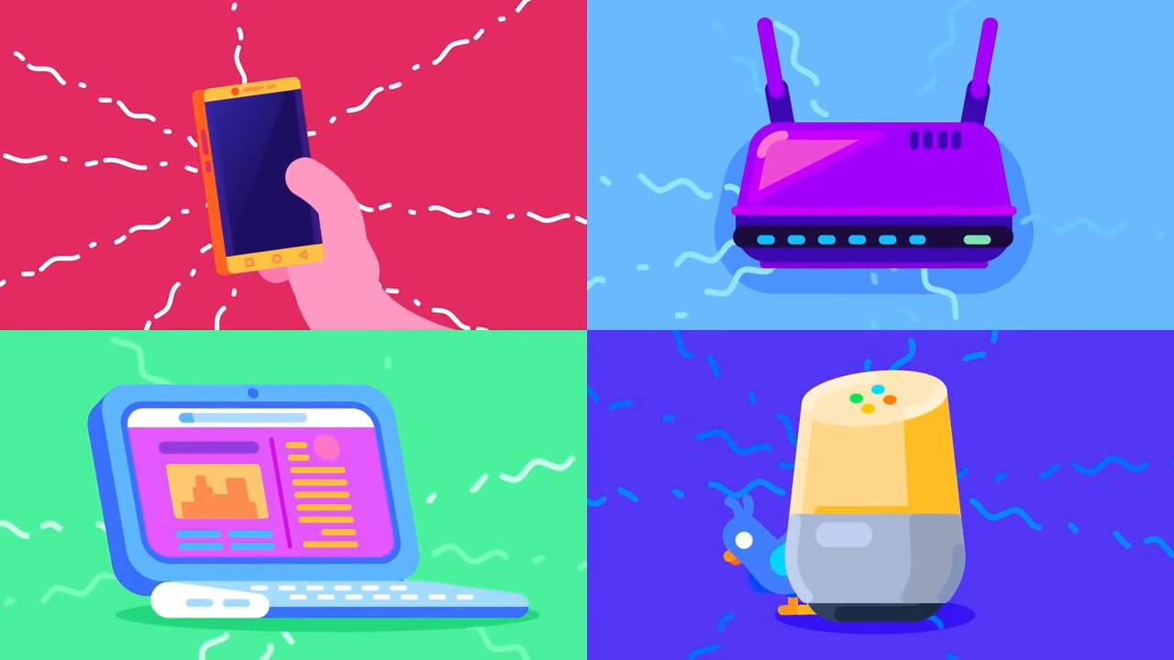
They are safe!

Slide 17
Thanks.

